Slide 1
P230 -> Drug Classification
Group 3
Mr Vinayak
Mr Pranay Matkar
Mr Vijay Sonkamble
Ms Varunika Palsetty
Ms Milissa Dabre
Under the guidance of :
Bapuram Pallavi

Slide 2
Business Objective :
Classification Of Patient Condition Based On Review.

Slide 3
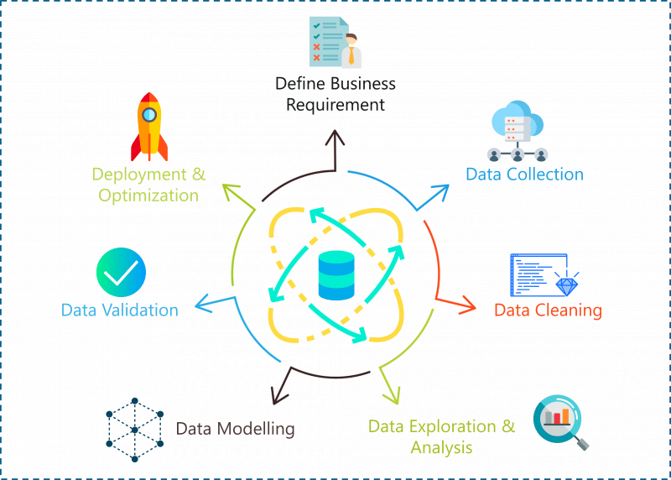
Project Flow :

Slide 4
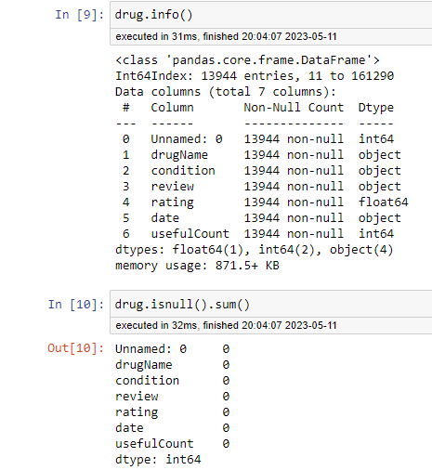
Analysis Of Data :
We have observed that they are 13944 rows and 7 columns.
There are no null values.

Slide 5
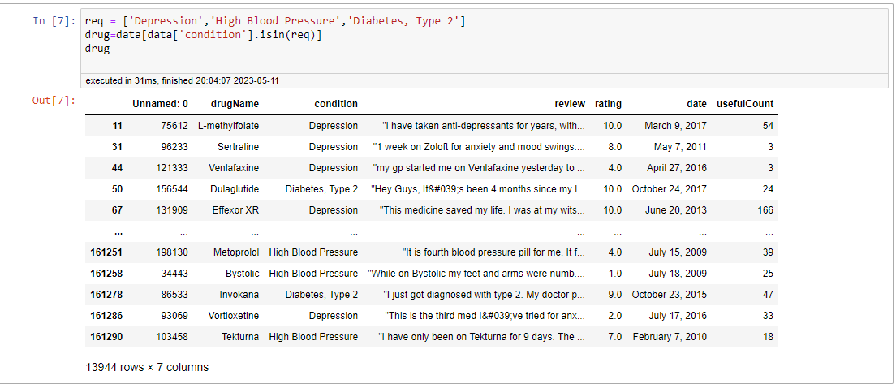
As per the given requirement we have to consider these 3 conditions i.e Depression, High Blood Pressure And Diabetes.

Slide 6
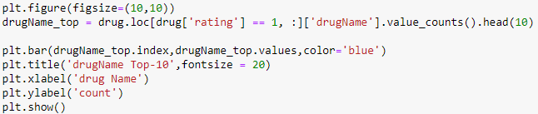
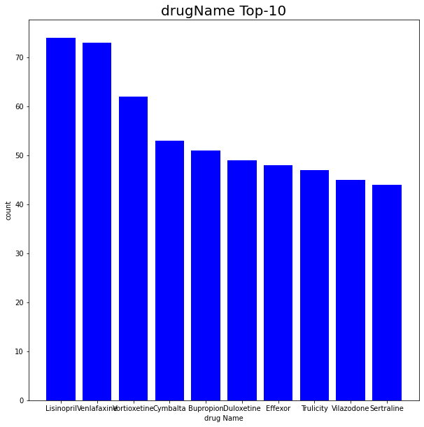
Data Visualization
As we can observe here are the highly rated drugs.
Lisinopril is the most preferred drug, followed by Venlafaxine and so on.

Slide 7
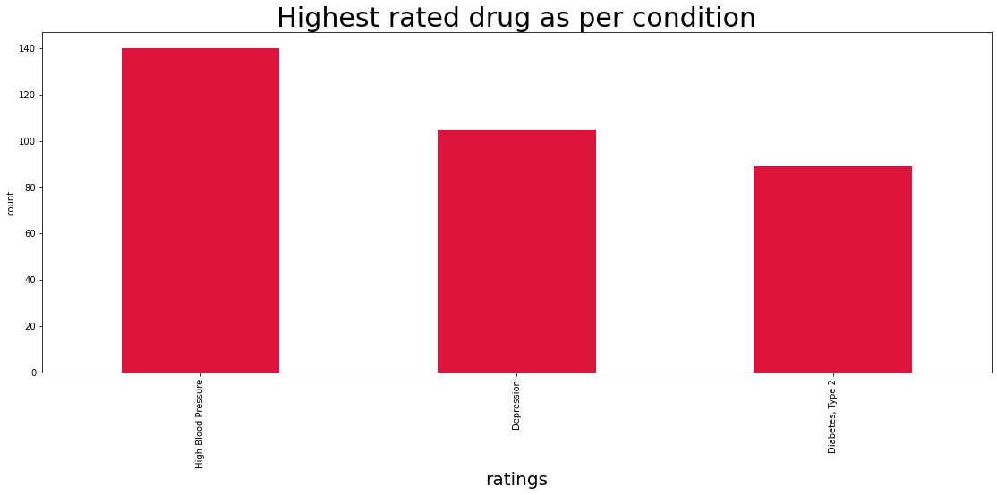
There are 140 different types of drugs which are given to the patient having High BP. 105 different type of drugs which are given to the patients having Depression. 89 different types of drugs which are given to the patients having Diabetes.

Slide 8
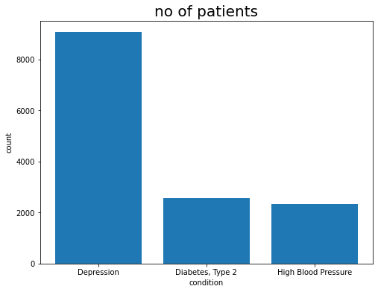
Here we can observe that there are more number of patients suffering from depression followed by diabetes, Type 2 and then blood pressure.

Slide 9
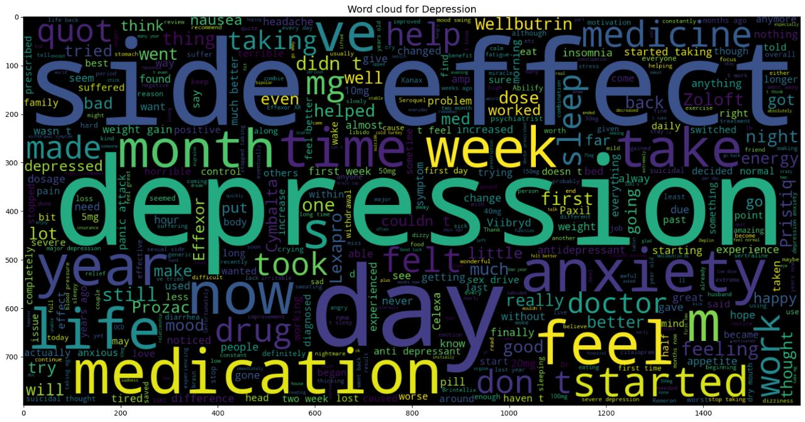
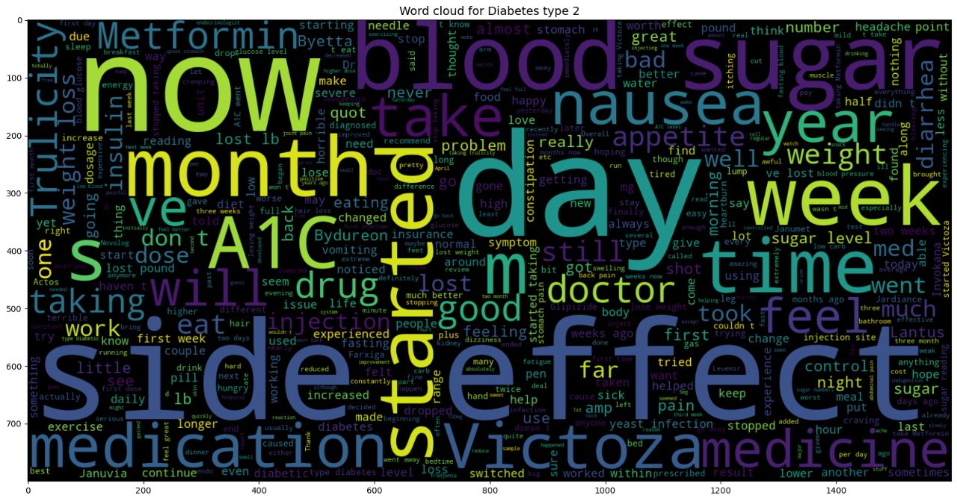
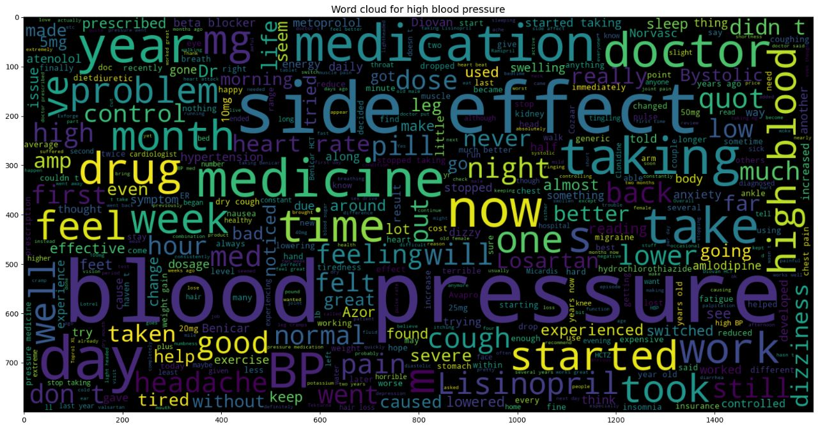
Word Cloud
Depression
Diabetes, Type 2
High Blood Pressure

Slide 10
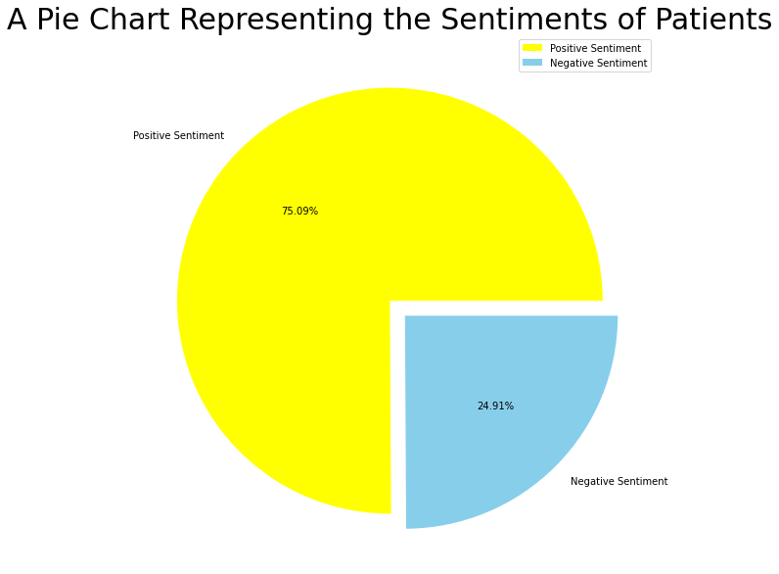
Sentiment Analysis
Here we can observe that amongst the review there are more number of positive reviews other than negative reviews.
Percentage of positive reviews is 75.09% and percentage of negative reviews is 24.91%.

Slide 11
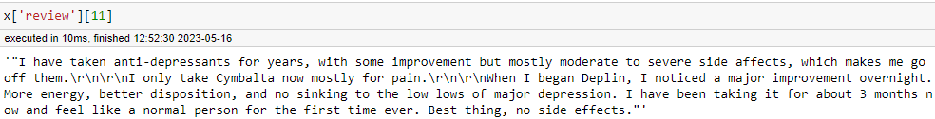
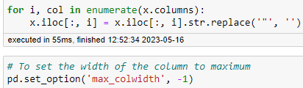
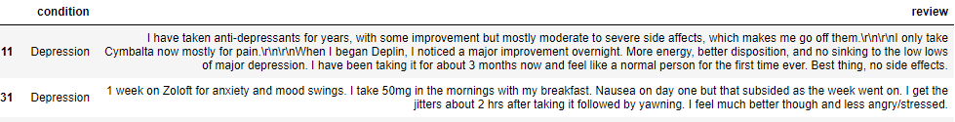
Data Pre Processing
Removing Punctuation Marks.

Slide 12
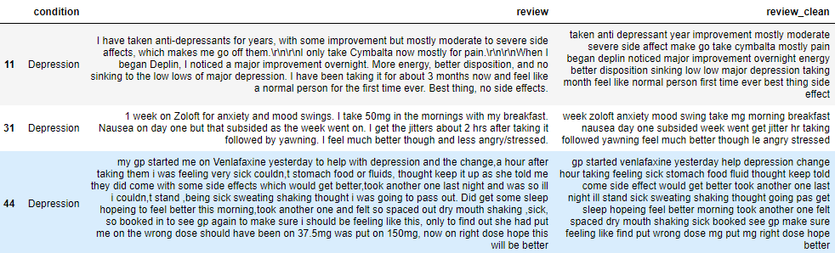
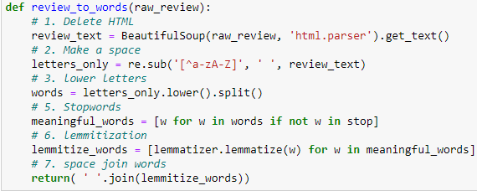
2)Removing Stop Words.
3)Delete HTML.
4)Make a space.
5)Lower Letters.
6)Lemmatization.
Data pre processing is done and here we can see the cleaned data.
And we will consider review clean for the model building process.

Slide 13
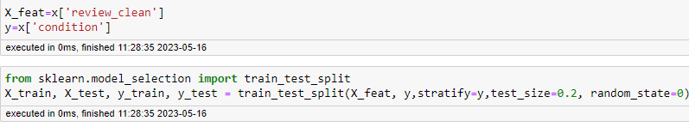
Train and Test Data :
We have considered review clean as independent variable.
And Condition as dependent variable.

Slide 14
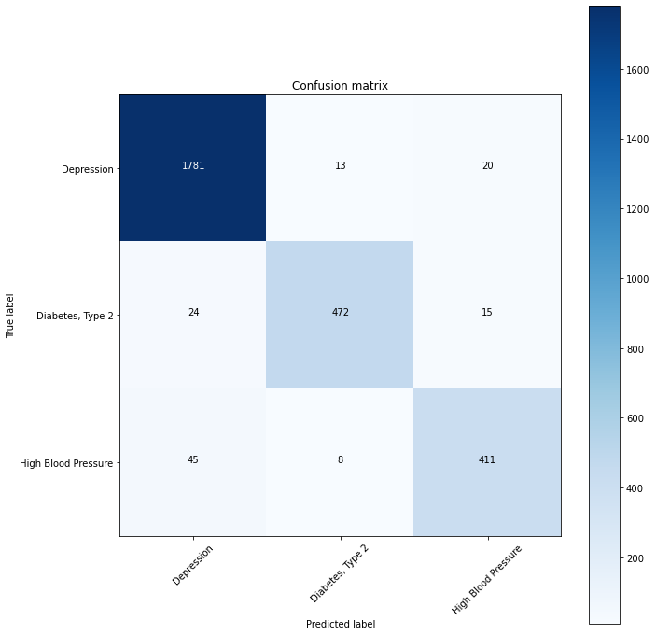
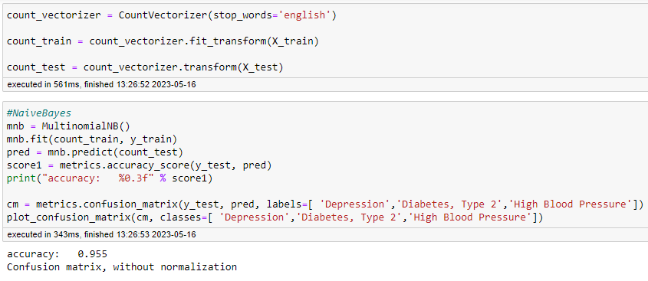
Model Building
1)Naive Bayes With Count Vectorizer.
By applying this we have achieved the accuracy of 95.5%.

Slide 15
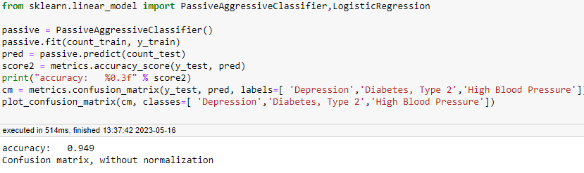
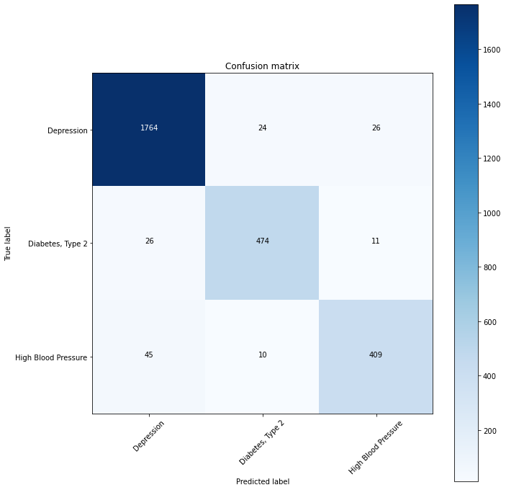
2)Passive Aggressive Classifier With Count Vectorizor.
.
By applying this we have achieved 94.9% accuracy.

Slide 16
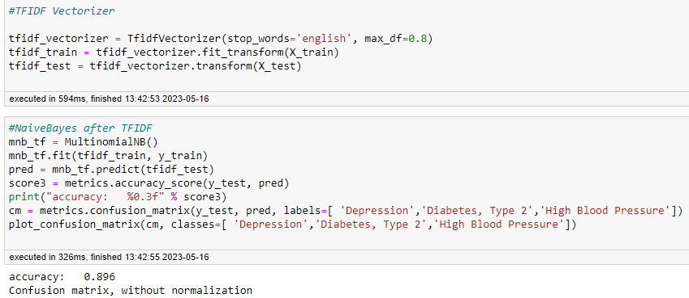
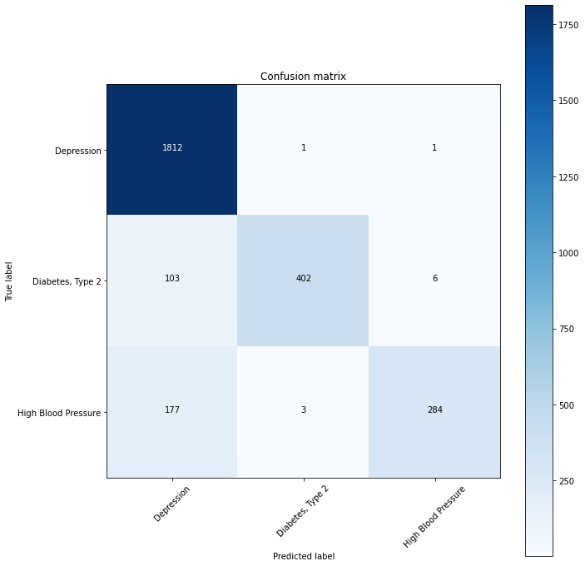
3)Naïve Bayes With TIDF Vectorizor.
By applying this we have achieved 89.6% accuracy.

Slide 17

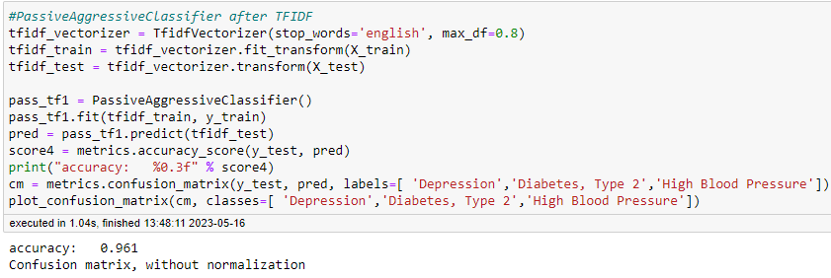
4)Passive Aggressive Classifier With TIDF Vectorizor.
By applying this we have achieved 96.1% accuracy.

Slide 18
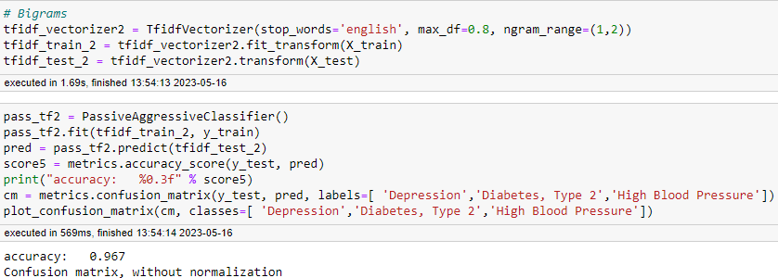

5)Passive Aggressive Classifier By Using Bigram Method.
By applying this we have achieved 96.7% accuracy.

Slide 19

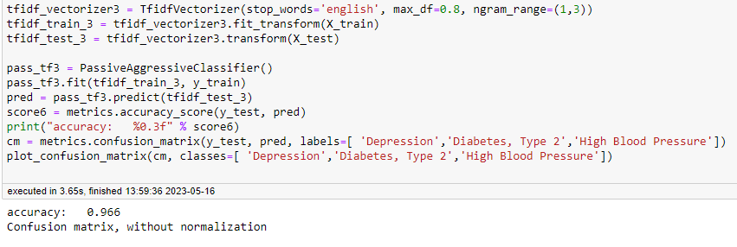
6)Passive Aggressive Classifier By Using Trigram Method.
By applying this method we have achieved 96.6% accuracy.

Slide 20
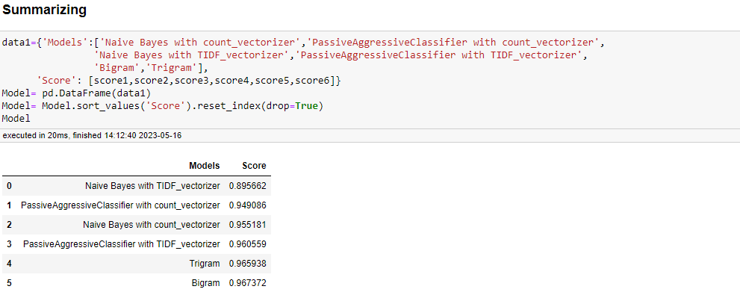
Overall Summary

Slide 21
Conclusion
We have choose Naive Bayes model for our data validation.

Slide 22
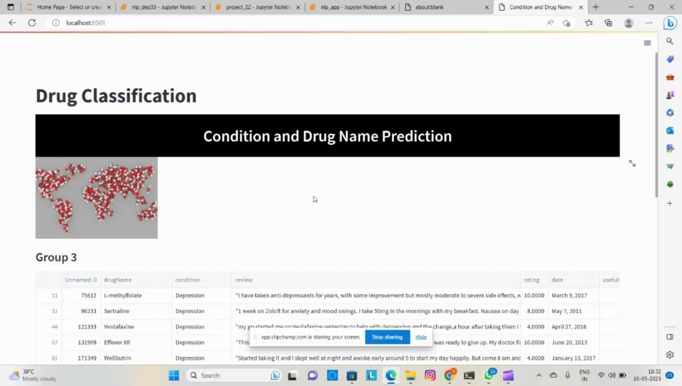
Deployment

Slide 23
Thank You.

